Slide 1

Weekly Report

Slide 2
Progress 16 November 2020 – 5 Januari 2021
Melanjutkan coding bagian aplikasi
Instagram

Slide 3
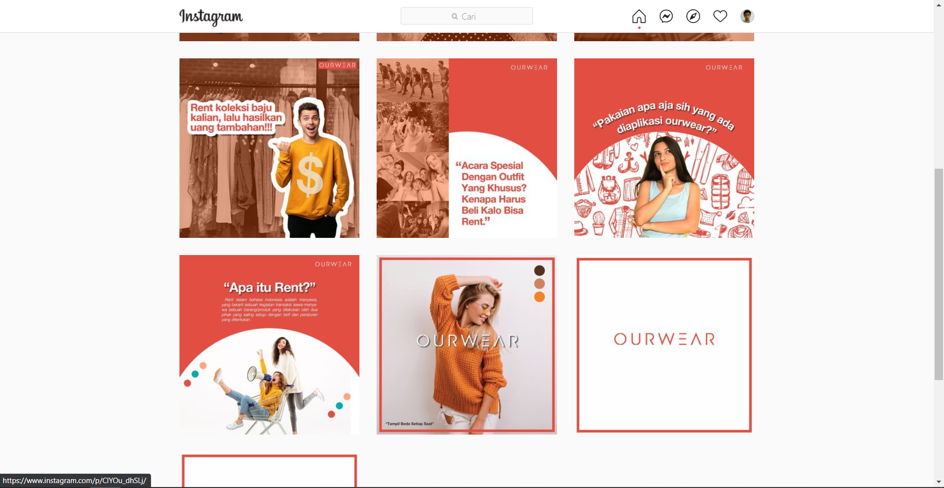
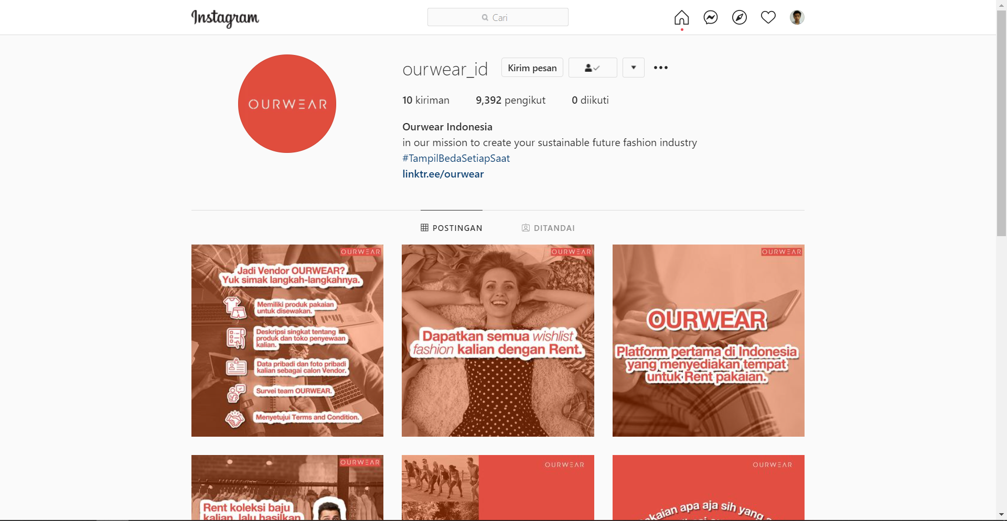
Instagram new post
New instagram post
https://www.instagram.com/ourwear_id/

Slide 4
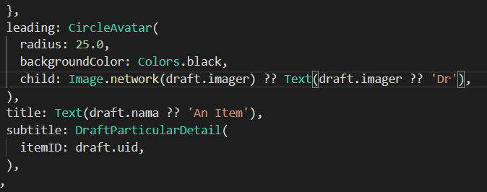
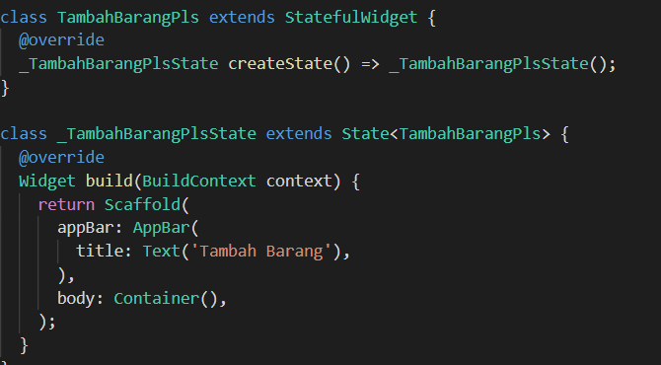
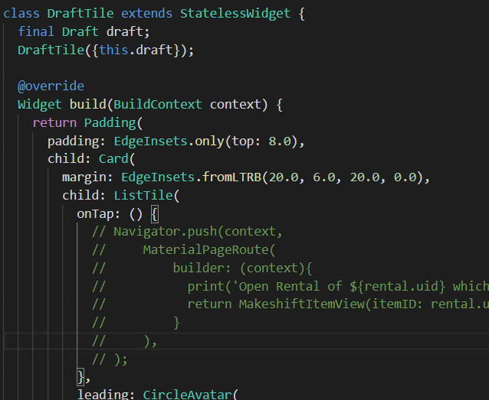
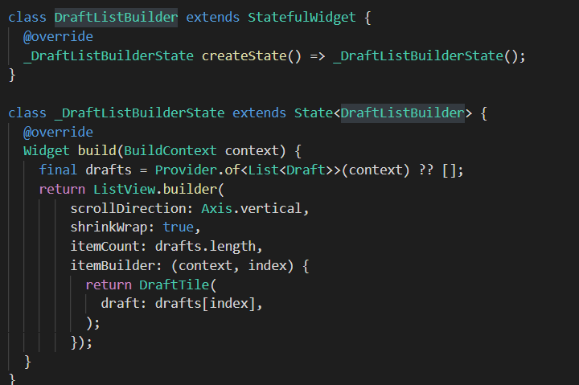
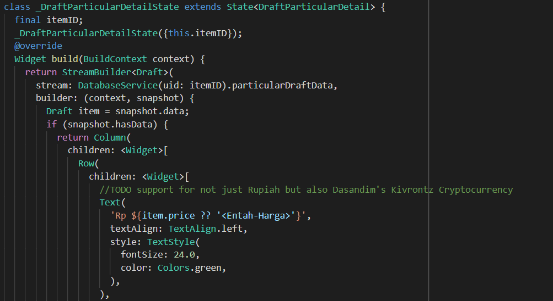
App
Draft add item
Draft list of items in draft
Draft item tile & detail

Slide 5
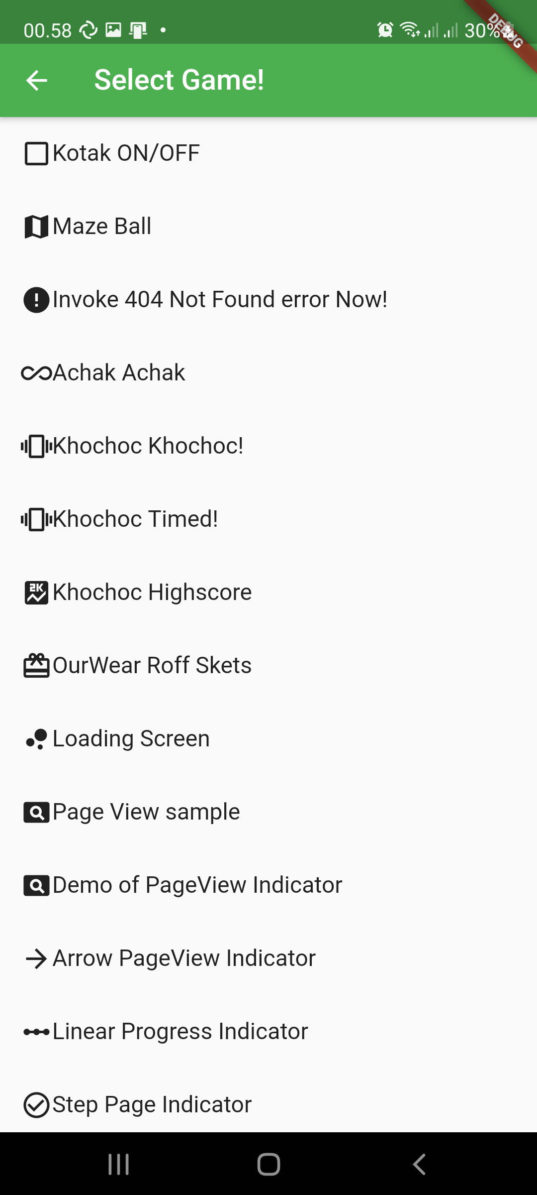
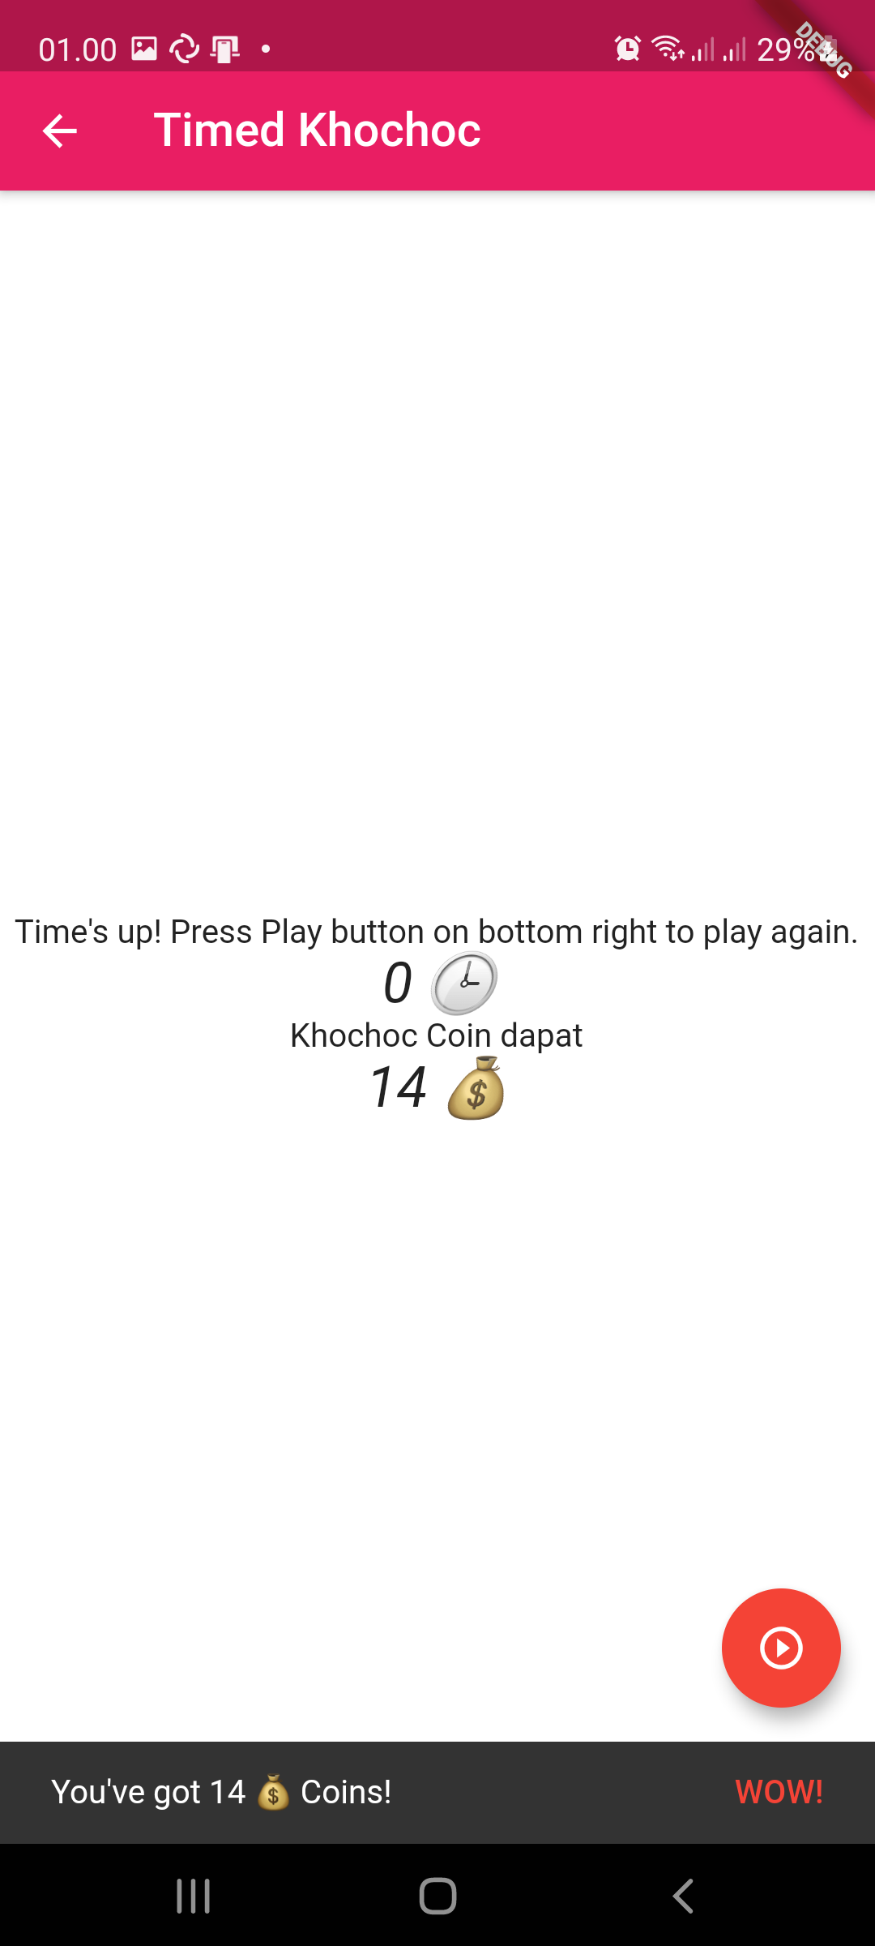
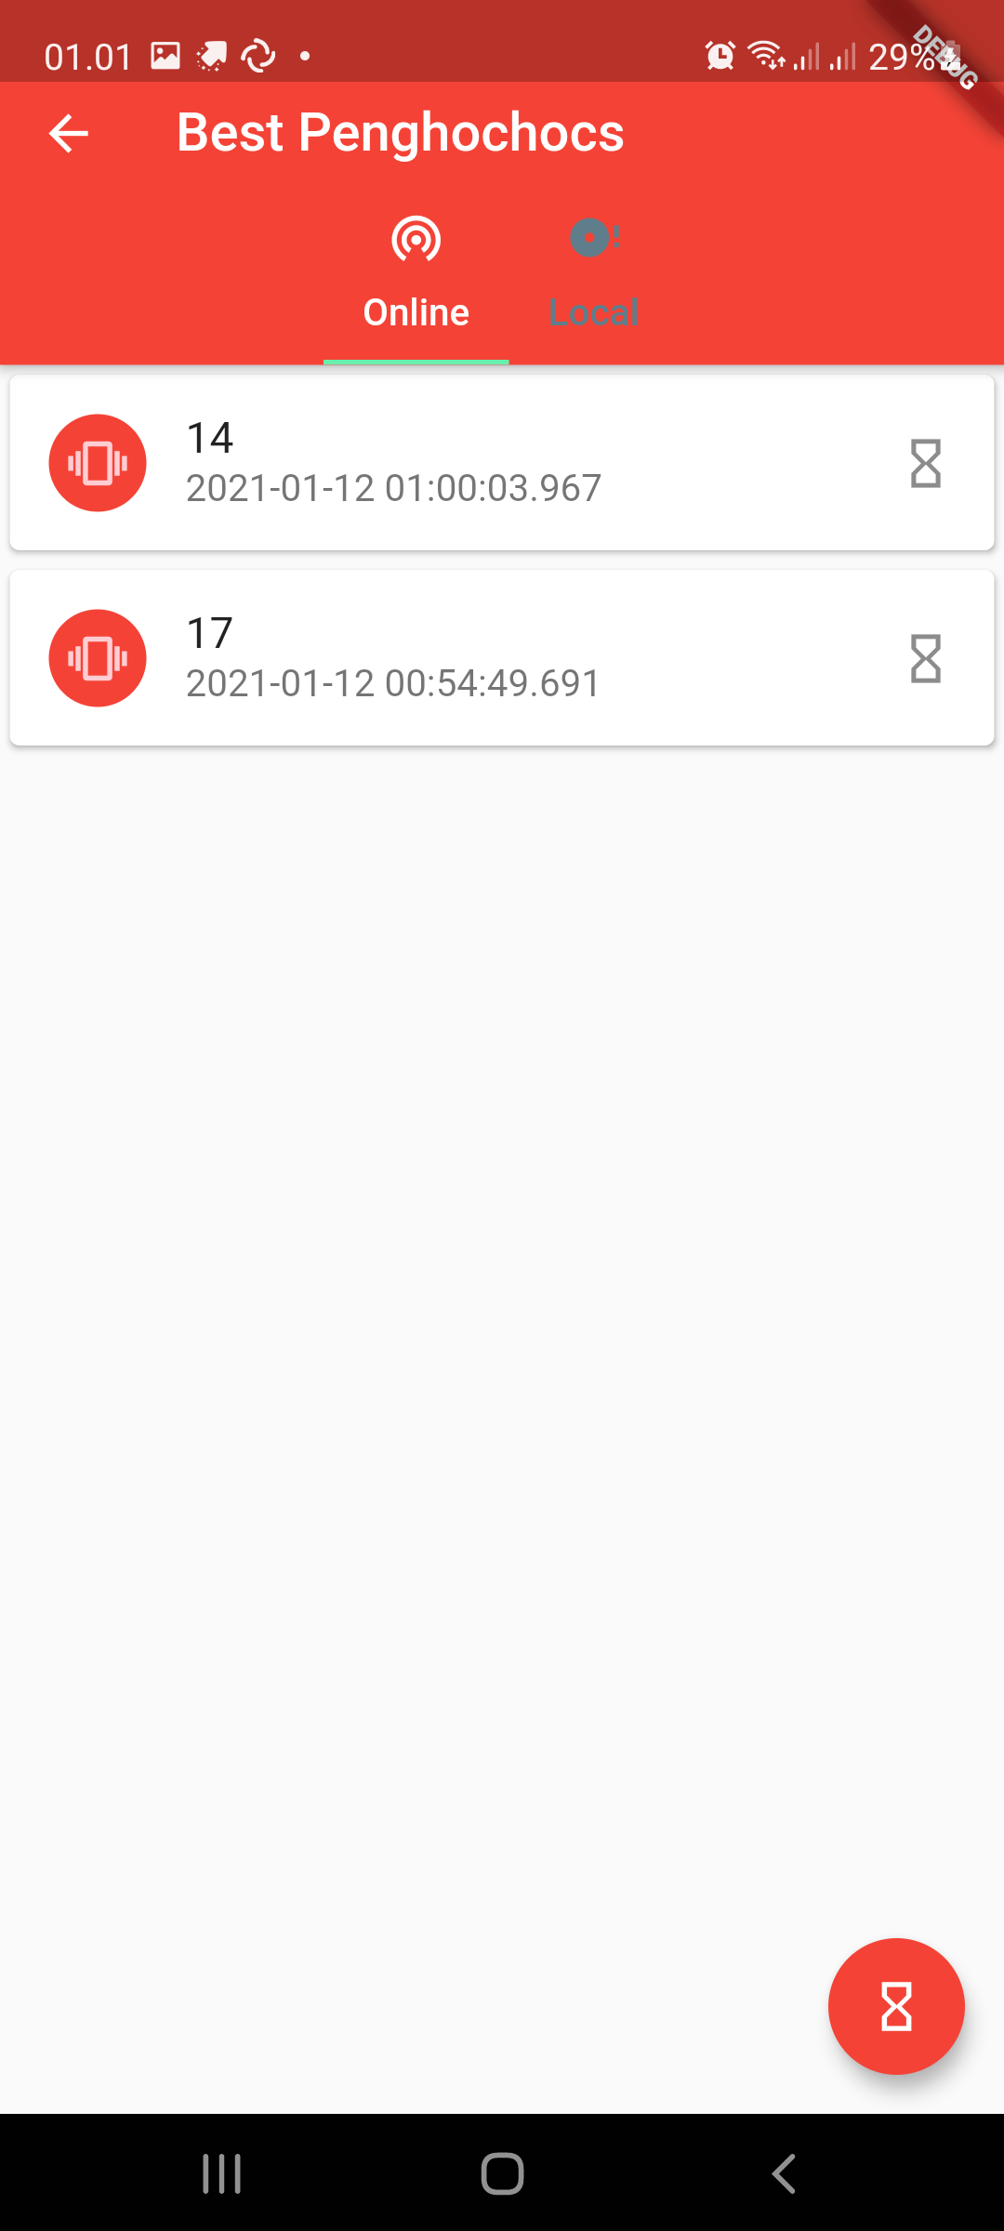
App
Pilihan minigame
Khochoc
Highscore

Slide 6
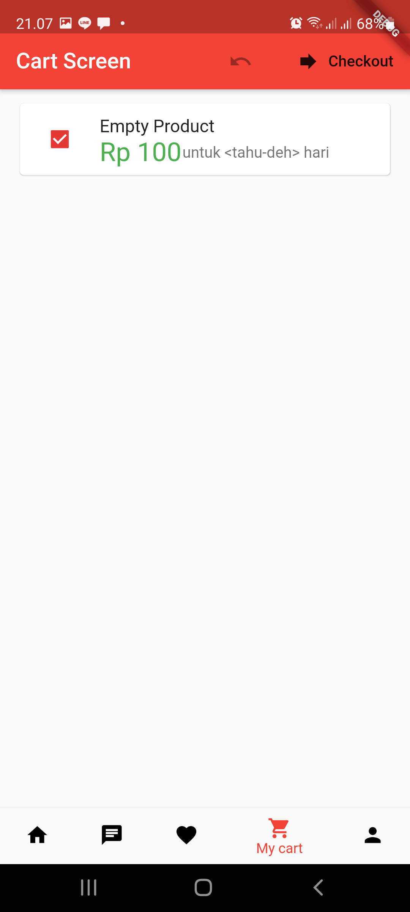
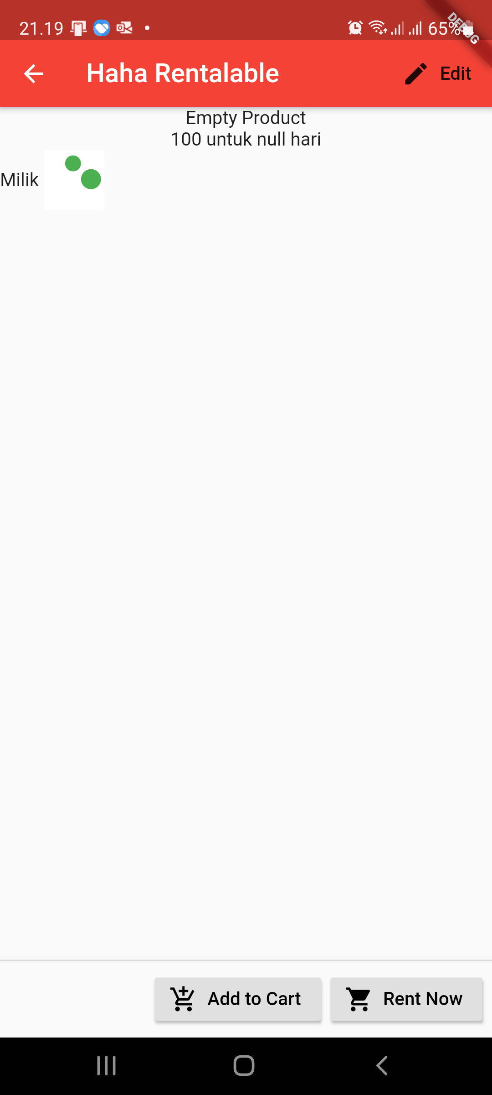
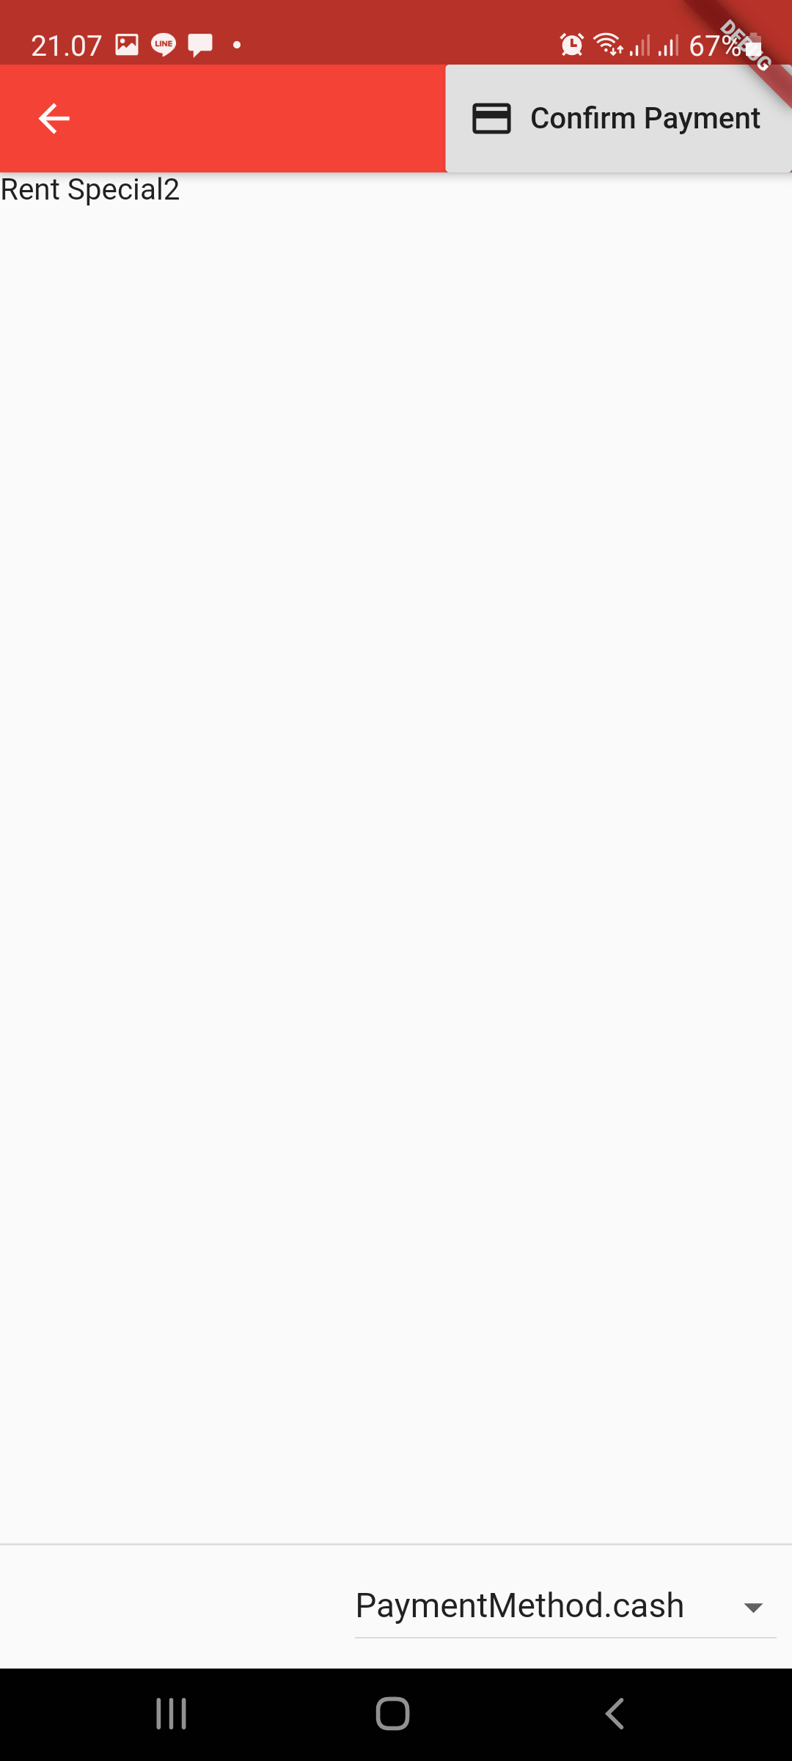
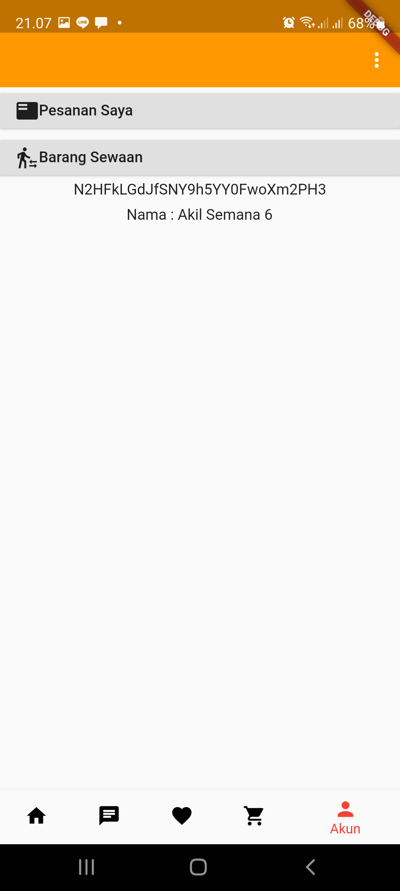
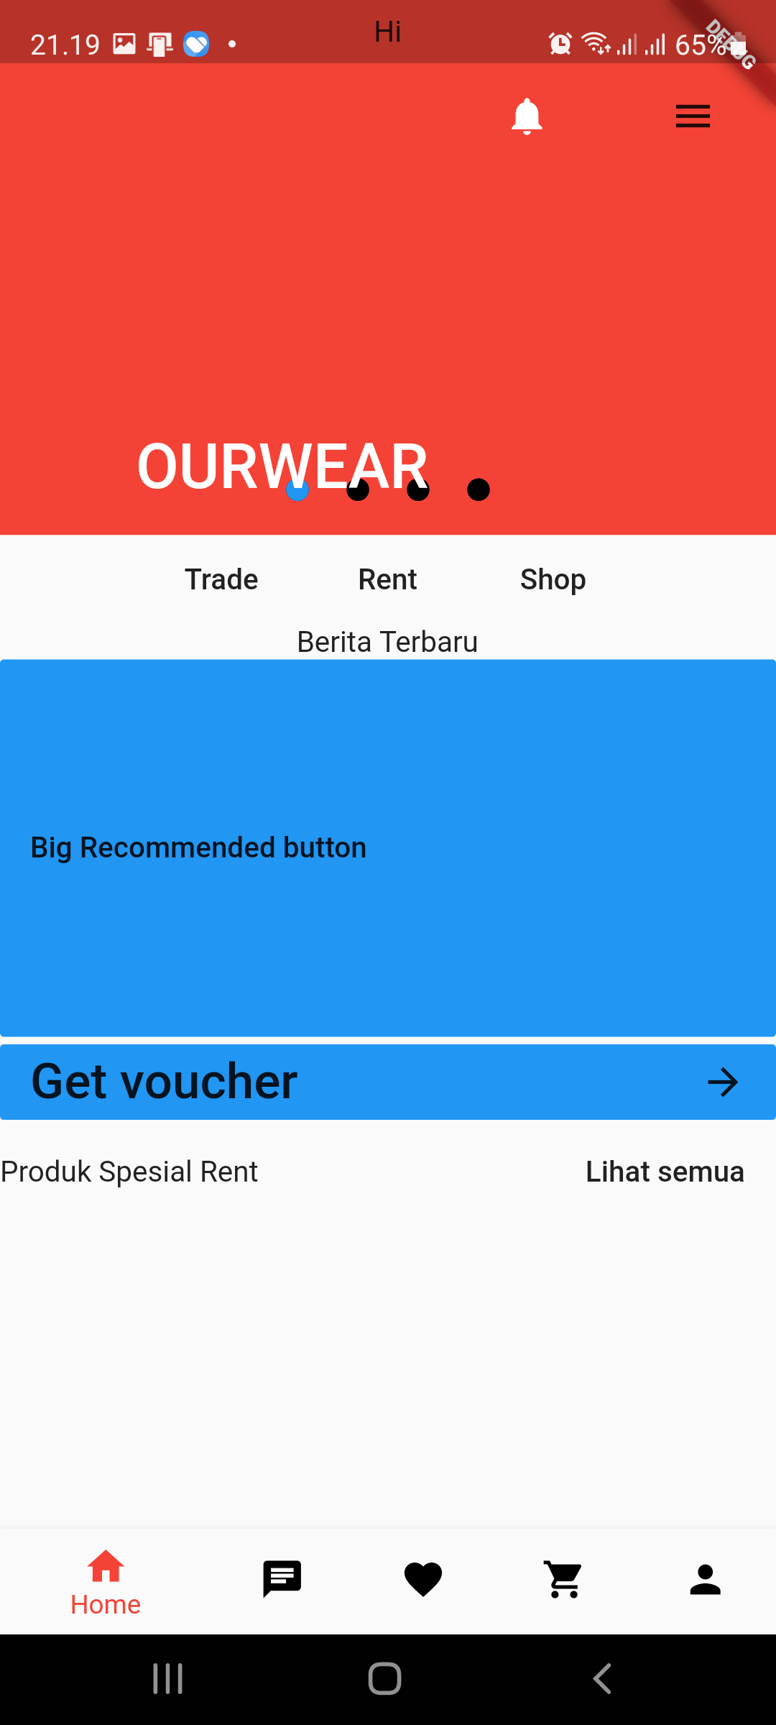
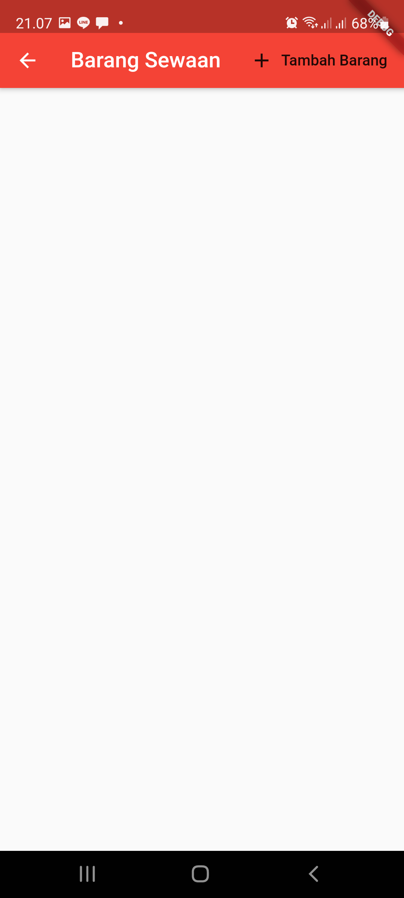
App
Beberapa Screenshot aplikasi

Slide 7
Hal lain (dari berbagai ruang diskusi)
Pembahasan chip
[5:16 PM]- Pembahasan endorsment
[5:18 PM]- Pembahasan Target 2021
[5:18 PM]- Instagram Adsense
[5:19 PM]- Ketemu vendor yang udh punya nama
[5:20 PM]- 2021 company profile
xd : - cara orang tau barang match
[5:43 PM]- cara tambah uang di trade
[5:43 PM]- match quick trade
[5:43 PM]- match trade biasa
https://www.niagahoster.co.id/blog/marketing-tools/
https://www.youtube.com/watch?v=H8sef06FRhs
https://www.prettylittlething.us/the-edit/ambassadors
https://www.prettylittlething.com/about
https://www.tokopedia.com/gmicsshop/cover-baju-jas-gaun-peva-anti-air-pelindung-baju-jas-gaun-anti-debu-120-x-60?src=topads

Slide 8
Doing Trello
Syarat Ketentuan
About Us
Kebijakan Privasi
Quick trade
XD akun
App dev
Feed instagram

Slide 9
To do Trello
Payment
Packaging
Proses Bisnis langganan
Quick rent
Copywriting
Vendor clothing & Laundry
Chip & Scanner tracking
XD penarikan saldo
XD tukar tambah uang dalam trade

